Slide 1

Development of web application components
for semantic annotation of datasets
Master's thesis project II
Author: Bc. Peter Plevko
Supervisor: Ing. Miroslav Rác
23.01.2024

Slide 2
Introduction
What is semantic
What is semantic annotation
Why is it important in business intelligence

Slide 3
Goals
Implementation of a web environment that simplifies the process of creating a semantic annotation
Managing and displaying annotations
Adding datasets, their subsequent annotation and export
Ensuring efficient data processing and supporting the evaluation of AI models.
Deploying the application to the cloud

Slide 4
Technologies
Frontend: Vue.js
CSS framework: Tailwind
UI component library: PrimeVue
Backend: NestJS
Database: Neo4j
Cloud Provider: Google Cloud Platform (GCP), firebase

Slide 5
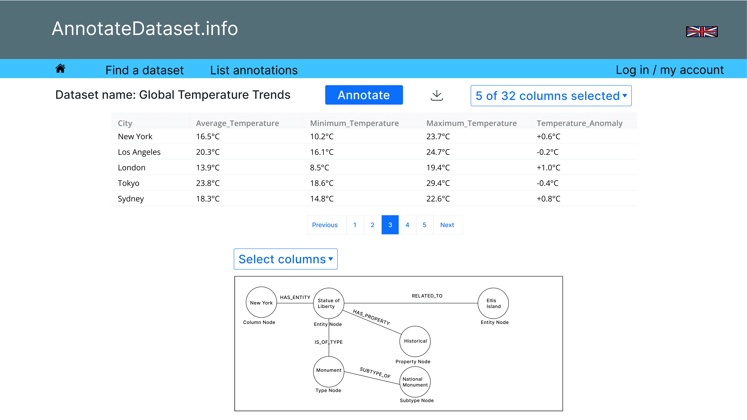
Wireframes

Slide 6
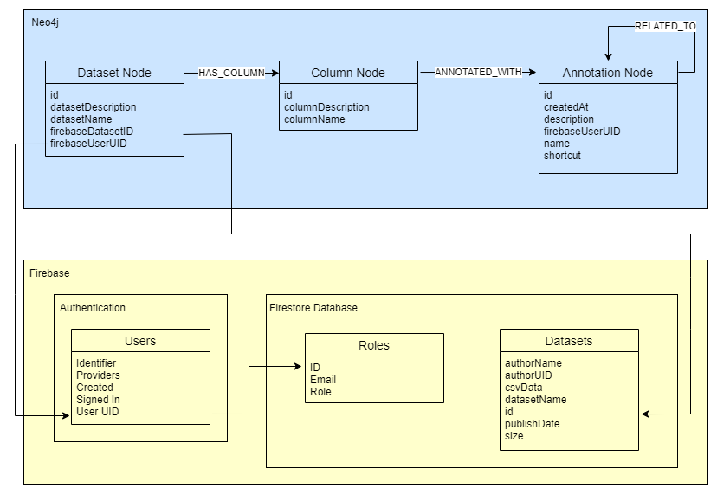
Database model

Slide 7
Seeders
mkt_synthetic
KAG_conversion_data
Ecommerce Customers

Slide 8
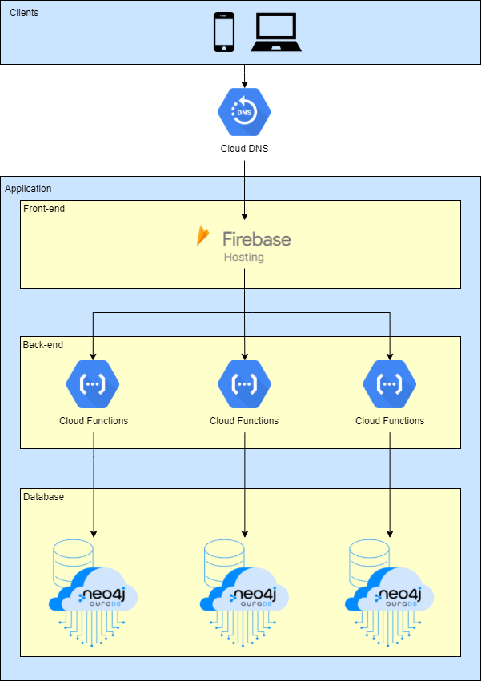
Google Cloud infrastructure diagram

Slide 9
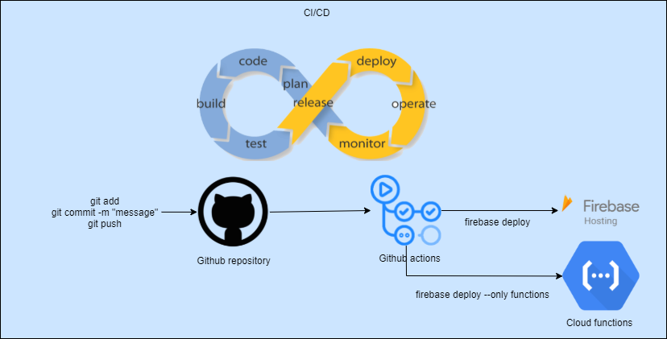
CI/CD

Slide 10
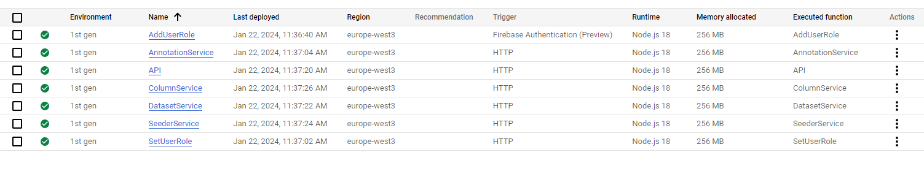
Cloud functions

Slide 11
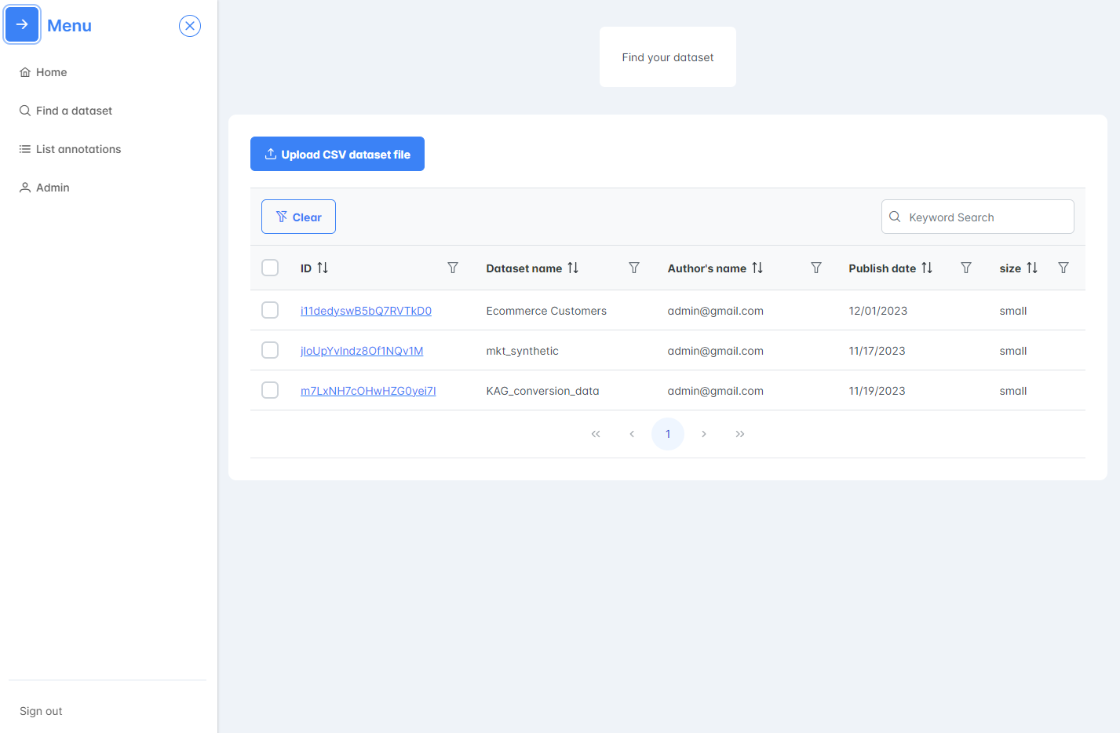
Find a dataset page

Slide 12
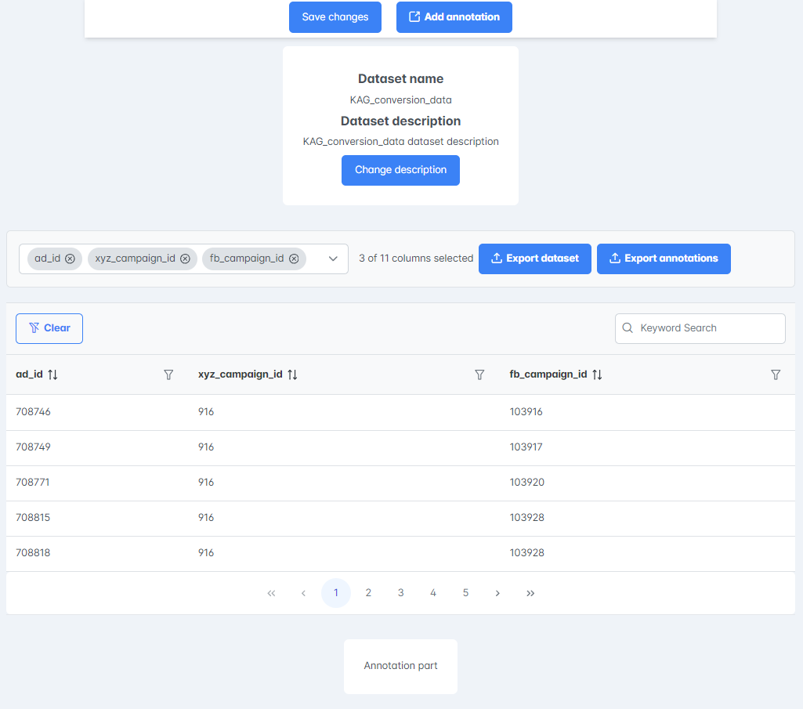
Selected dataset page 1

Slide 13
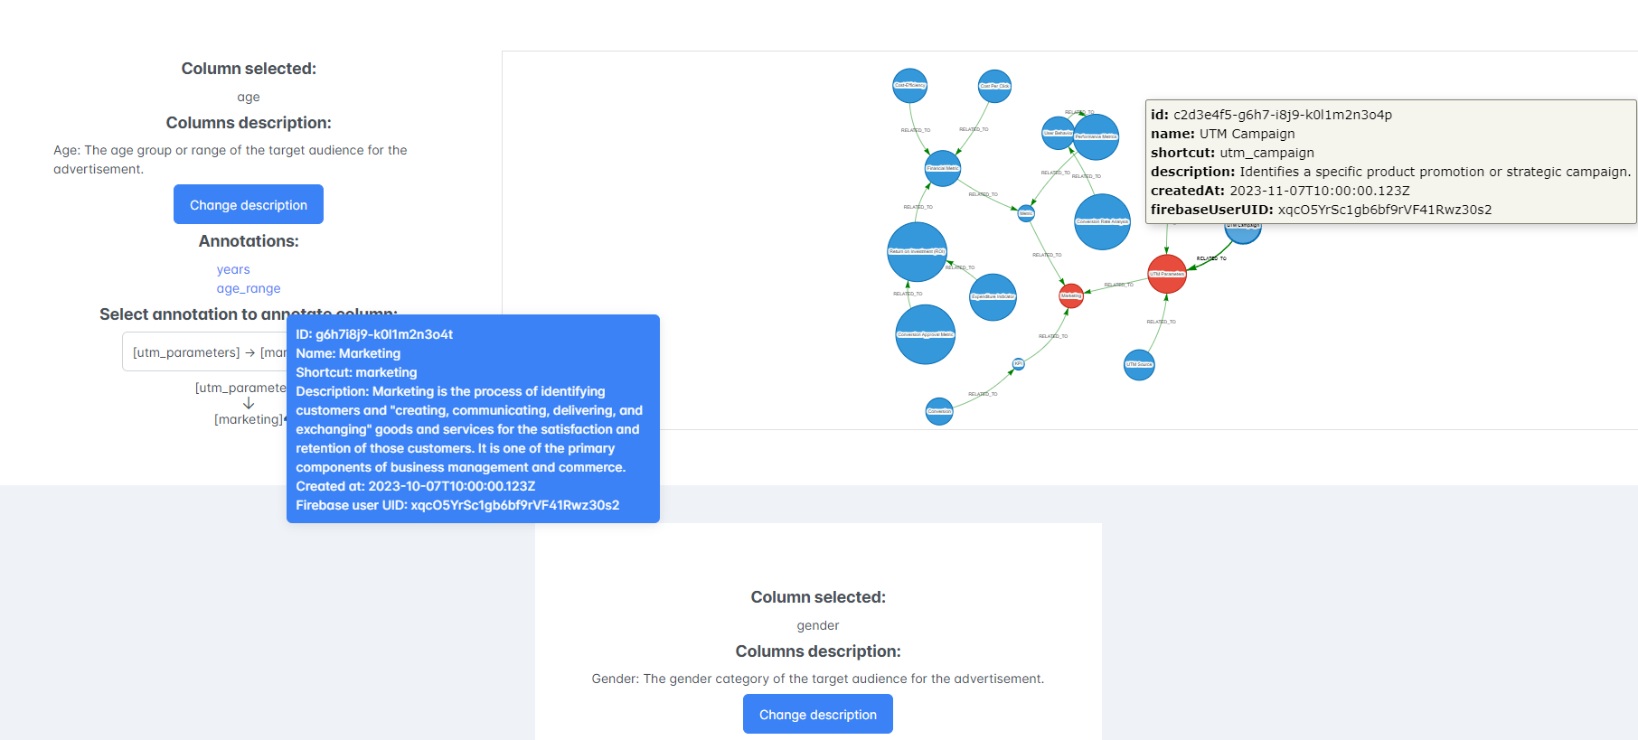
Selected dataset page 2

Slide 14
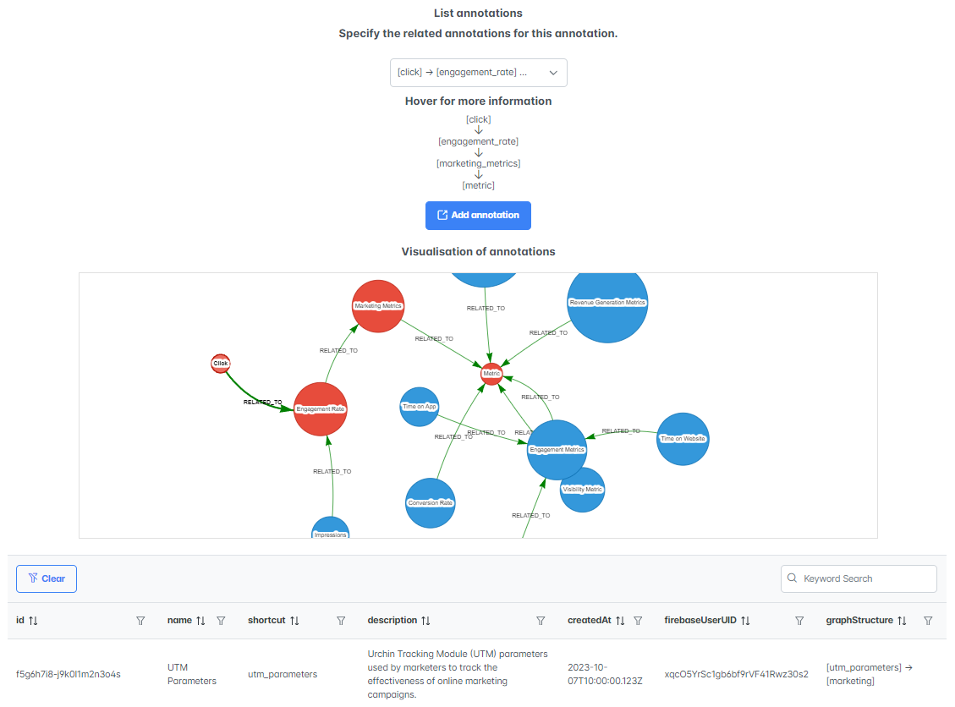
List annotations page

Slide 15
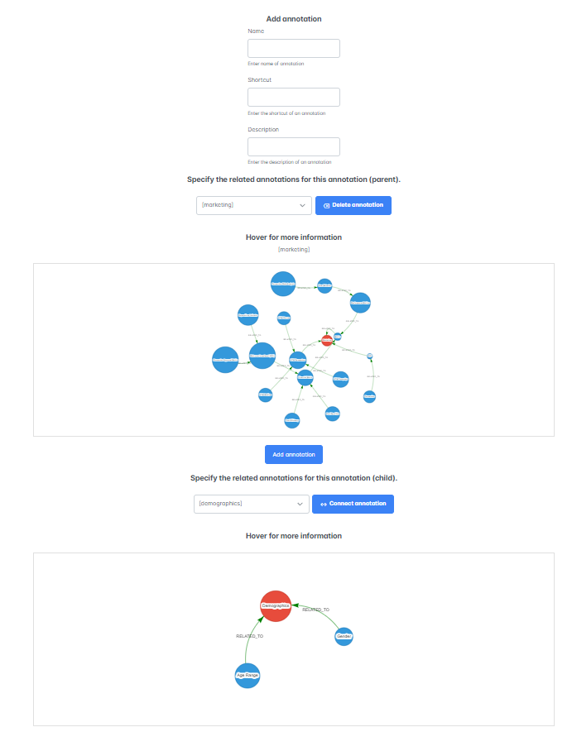
Add annotation page

Slide 16
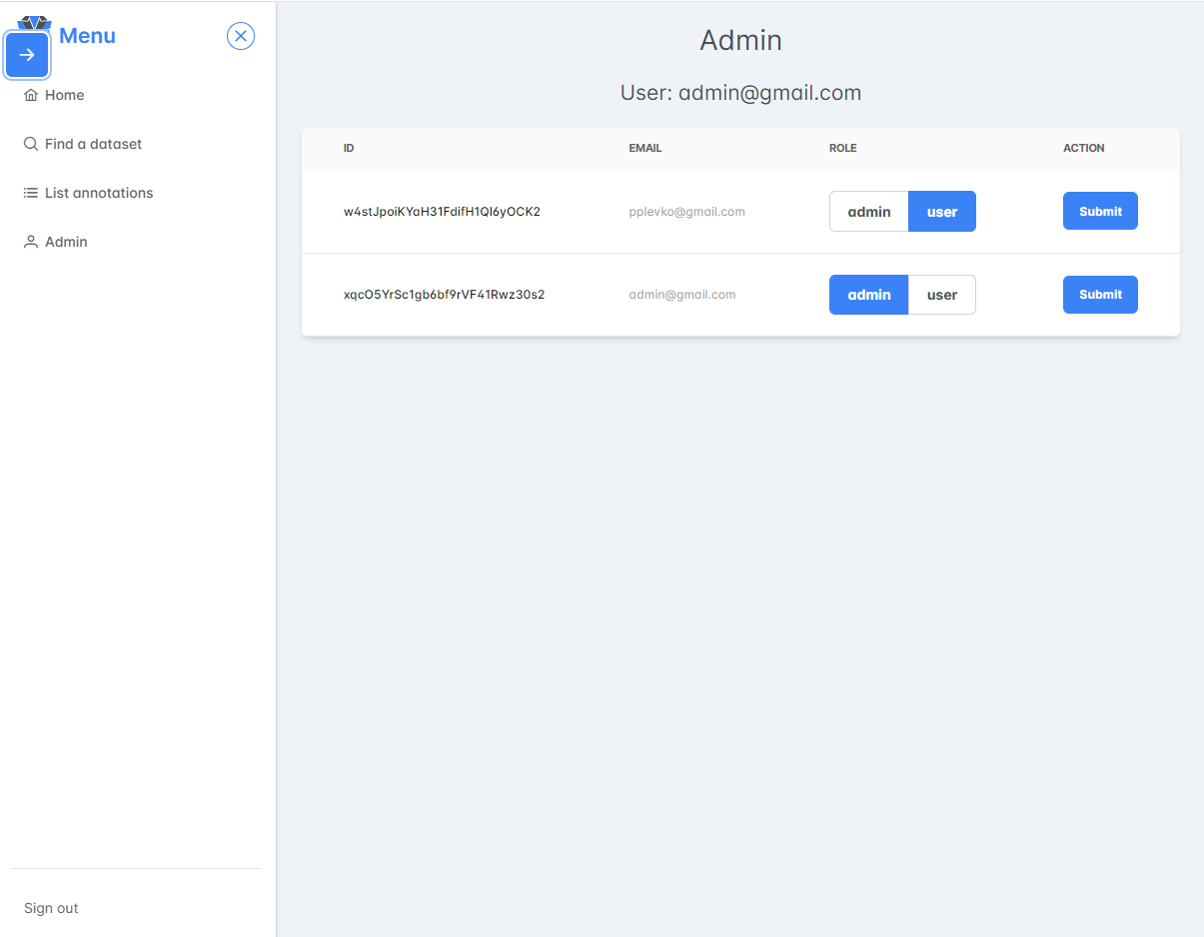
Admin page

Slide 17
Link to website
https://diploma-thesis-project-c46d9.web.app/

Slide 18
Future work
Annotation suggestions
User testing
Using a different database with the repository pattern
Removing restriction for dataset size

Slide 19
Questions and discussion

